Slide 1
Why is code replication important for psychological experiments?
Vryan Feliciano – cognitivetoolslab, Fall 2022
Notes:
Why is replication important for code-based experiments?
— —
Importance of code replication in psychology experiments
Or a question

Slide 2
01
Why are replication studies important?
02 What did i replicate?
03
replication
results
04
Math background exploratory analysis
01
02
03
04
Notes:
So, you may be wondering what I've been doing this past quarter in the cognitivetoolslab…
I've been conducting a replication study on HL's FYP, on graph comprehension
But what does that mean? There's two important themes here:
[CLICK] I'm conducting a replication study – why is that important?
[CLICK] What did I replicate regarding HL’s FYP, what was my research design?
[CLICK] After establishing that, I’ll go into my replication proper
[CLICK] And then I’ll talk about an exploratory analysis I did based on additional data we collect about participant’s math backgrounds

Slide 3
01.
Why are replication studies important?
01
02
03
04

Slide 4

Why are replication studies important?
Can we trust the code we write?
Replication Study Setup:
I only got HL’s research questions
Same study design, but w/ larger sample
I had to code everything myself
01
02
03
04
Notes:
I mean it's always good to reverify your results BWAHAHAH
[CLICK] But for cognitivetoolslab specifically, there's a lot of coding involved… [CLICK] Can we trust the code we write?
Does our code measures the constructs we're interested in accurately and correctly?
for science in general, when coding is involved, everyone codes differently! If everyone in this lab were assigned to solve the same problem we’d all have different coding solutions – do all those different solutions get the same answer to the same problem?
So! What I’ve been doing this past quarter is addressing that question by replicating HL’s FYP. [CLICK] Here was our replication study setup:
I only get HL’s research questions
I worked with a larger sample using the same study design
I had to code everything myself
And that’s pretty cool, no? If I replicate HL’s results, then HL’s methods are valid and the trends HL found is a reproducible within the data!

Slide 5
02.
What did i replicate?
01
02
03
04
Notes:
What did I replicate?

Slide 6
How well are people doing on these tests and which types of questions seem to be most difficult?
Does how well people are doing on these tests and thetypes of questions seem to be most difficult replicate?
How consistently do people succeed on questions of the same type?
Does how well people are doing on these tests and the types of graph seem to be most difficult replicate?
Does how consistently do people succeed on questions of the same type and same graph replicate?
Hannah’s fyp
My replication study
Study Design
N = 116
N = 735
01
01
Replication Questions?
02
02
03
Exploratory Analysis, based on participant’s math history
01
02
03
04
Notes:
Let’s compare Hannah’s FYP [CLICK] and My Replication Study [CLICK] :
[CLICK] Study Design remains the same, [CLICK] as a reminder it’s based on evaluating participants with two graph comprehension assessments: [CLICK] GGR and [CLICK] VLAT; [CLICK] the sample size is different, because my sample is an extremely expanded sample [CLICK]
We focused on replicating these two questions: [CLICK][FOLLOW]
Specifically, [CLICK][FOLLOW] I’m replicating participant’s performance on question types AND graph types, and the reliability of participant’s performance.
[CLICK] Last, separate from the replication, I conduct an Exploratory Analysis based on a participant’s math history
—
Table comparing Hannahs FYP and Vryans 199 project
The guideline for replicating the project

Slide 7
03.
Replication results
01
02
03
04
Notes:
Replication results

Slide 8
GCB REPLICATION PROJECT QUESTIONS
Does how well people are doing on these tests and the types of questions that seem to be most difficult replicate?
Does how well people are doing on these graphs and the types of graphs that seem to be most difficult replicate?
Does how consistently do people succeed on questions of the same type replicate?
Does how consistently do people succeed on questions of the same graph replicate?
01
02
03
01
02
03
04
Notes:
Formally, here are the research questions I replicated:
[CLICK] #1
[CLICK] #2
[CLICK] #3 Does how consistently people succeed on questions of the same type or graph replicate?
Let’s get into it!

Slide 9
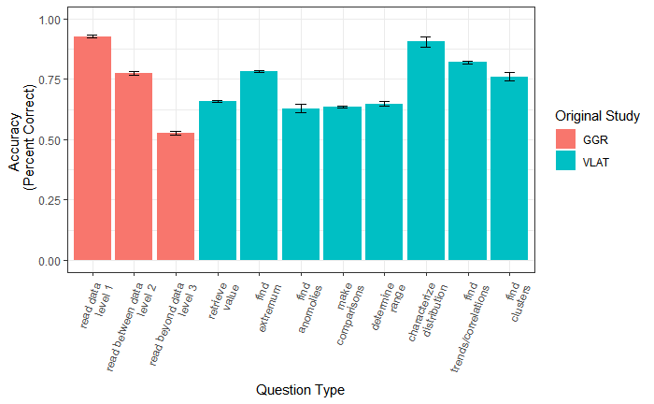
Does how well people are doing on these tests and the types of questions that seem to be most difficult replicate?
01
01
02
03
04
Notes:
For the first question, I produced this graph: the x-axis is the question type, divided between what original study they came from: [CLICK] GGR or [CLICK] VLAT. The y-axis is average question accuracy among participants [CLICK] [CLICK]
[CLICK] Looking at just GGR, we expect to see that higher level, difficult questions participants get less correct; what we see is a nice ladder trend for GGR questions! [CLICK] But when we look at VLAT, there no discernable pattern for VLAT.
Compared to HL’s plots, there are increases in VLAT’s [CLICK] Find Anomalies and [CLICK] Determine Range; there is only one decrease in [CLICK] GGR’s Level 3. Despite this, the general pattern she found is replicated with my attempt.
— y axis has 1.0 on it

Slide 10
GCB REPLICATION RESULTS
Does how well people are doing on these tests and the types of questions that seem to be most difficult replicate?
01
Successful replication, as the trend has not changed significantly: GGR results consistent w/ expected 3-level hierarchy, but no such clear hierarchy in VLAT results.
01
02
03
04
Notes:
So the result of the [CLICK] first question is the following: [CLICK] successful replication, as the trend has not changed significantly. [CLICK]

Slide 11
GCB REPLICATION RESULTS
Does how well people are doing on these tests and the types of questions that seem to be most difficult replicate?
Does how well people are doing on these graphs and the types of graphs that seem to be most difficult replicate?
01
Successful replication, as the trend has not changed: GGR results consistent w/ expected 3-level hierarchy, but no such clear hierarchy in VLAT results.
02
01
02
03
04
Notes:
For the second question: [CLICK] (read the question)

Slide 12
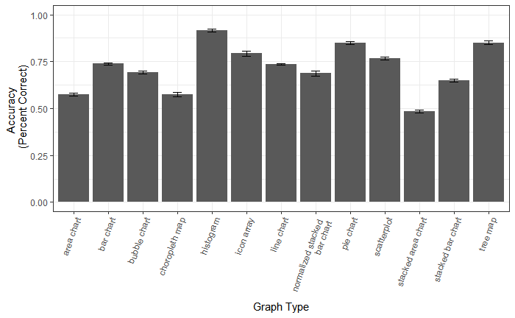
Does how well are people doing on these graphs and types of graphs seem to be most difficult replicate?
02
01
02
03
04
Notes:
This is the graph I produced: [CLICK] X-axis is graph types participants were evaluated on; [CLICK] y-axis is again how accurate participants were on average
Increases in performance for the following graphs: [CLICK] bar charts and [CLICK] scatterplots.
But overall, there’s only a weak correlation at best.

Slide 13
GCB REPLICATION RESULTS
Does how well people are doing on these tests and the types of questions that seem to be most difficult replicate?
Does how well people are doing on these graphs and the types of graphs that seem to be most difficult replicate?
01
Successful replication, as the trend has not changed: GGR results consistent w/ expected 3-level hierarchy, but no such clear hierarchy in VLAT results.
02
Successful replication: graphs have a weak association. Participants do well on graphs that are relatively common but are less accurate for more involved visualizations.
01
02
03
04
Notes:
So, we found another successful replication: [CLICK] graph type has a weak association.

Slide 14
GCB REPLICATION RESULTS
Does how well people are doing on these tests and the types of questions that seem to be most difficult replicate?
Does how well people are doing on these graphs and the types of graphs that seem to be most difficult replicate?
Does how consistently do people succeed on questions of the same type replicate?
Does how consistently do people succeed on questions of the same graph replicate?
01
Accuracy increases for some tasks, compared to HL. Still, the trend has not changed: GGR results consistent w/ expected 3-level hierarchy, but no such clear hierarchy in VLAT results.
02
Successful replication: graphs have a weak association. Participants do well on graphs that are relatively common but are less accurate for more involved visualizations.
03
01
02
03
04
Notes:
[CLICK] Last question is a pair: how consistently do people succeed on questions of the same type and graph replicate?

Slide 15
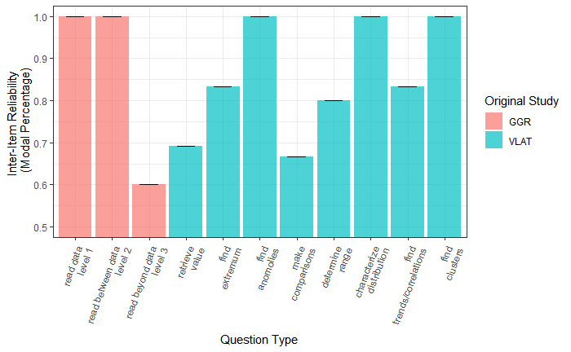
Does how consistently do people succeed on questions of the same type replicate?
Does how consistently do people succeed on questions of the same graph replicate?
02
What is inter-item reliability (ITR)?
ITR is a measure that tells us how consistently a sample responded correctly OR incorrectly.
01
02
03
04
Notes:
For the first sub-question about question type, here’s the graph: [CLICK] X-axis is again question type [CLICK]. [CLICK] But the y-axis is inter-item reliability!
[CLICK] What is inter-item reliability? [CLICK] It’s a measure of how consistently a sample responded correctly OR incorrectly, by taking the mode of their responses! It’s not a function in R like mean() or mode() because it’s a more involved calculation that we have to code ourselves!
You will notice that the scale goes from [CLICK] 0.5 to [CLICK] 1.0. 1 indicates participants either getting ALL questions of a certain type correct or incorrect; vice versa with 0.5, which is the minimum value. Again, ITR only measures if you’re performing in a consistent manner, not if you’re correct/incorrect
And this is the graph I got! [CLICK] Except, there’s a problem…
—---
HLs way of describing ITR:
This measure tracks how consistently people were answering questions of a certain type correctly OR incorrectly
So a value of 1 would mean that participants were consistently getting either ALL of the questions right or ALL of the questions wrong within a question type
The minimum reliability is 0.5, which would occur if a participant did not answer any more questions correctly than they did incorrectly.
If these question types really correspond to some underlying set of independent primitives — this measure should be high across the board.
Describe what it means to have a value of 0.5, and a value of 0.9

Slide 16
Does how consistently do people succeed on questions of the same type replicate?
Does how consistently do people succeed on questions of the same graph replicate?
02
01
02
03
04
Notes:
Let’s explain this concretely. For example: [CLICK] for the task find extremum, let’s say the mode proportion of correct of all participants is 83% – we assign that as our modalp for each participant overall. A specific participant might have actually gotten 65%, but their modalp would still be 83% because most people scored 83%.
What does that 83% mean? 83% participants are either reliably having high accuracy 83% or having not high accuracy 83% – inter-item reliability doesn’t differentiate this, so we don’t know!
But… I’ve been misleading y’all. [CLICK]
—---
Describe what it means to have a value of 0.5, and a value of 0.9

Slide 17
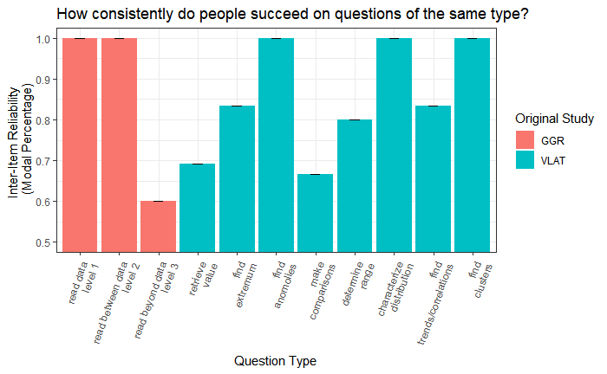
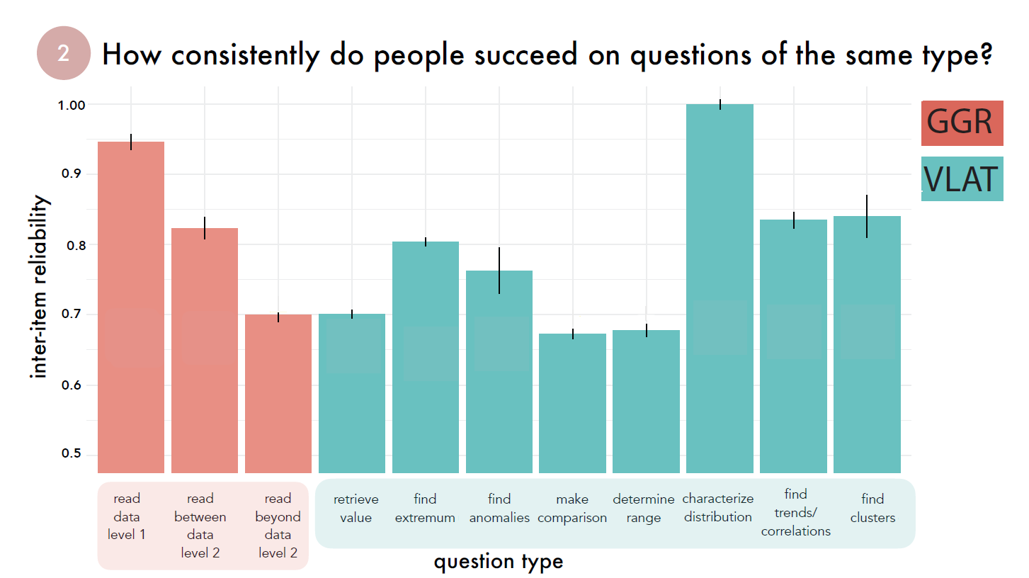
Does how consistently do people succeed on questions of the same type replicate?
Does how consistently do people succeed on questions of the same graph replicate?
02
Vryan’s:
Hannah’s:
01
02
03
04
Notes:
So this is the graph I got. [CLICK] This is what Hannah got. [CLICK] THEY’RE NOT SIMILAR!
Especially since I’m trying to replicate HL’s results, ITR is something that we had to code on our own! If I get different from HL, it implies that ITR is an unreliable construct!
—---
Describe what it means to have a value of 0.5, and a value of 0.9

Slide 18
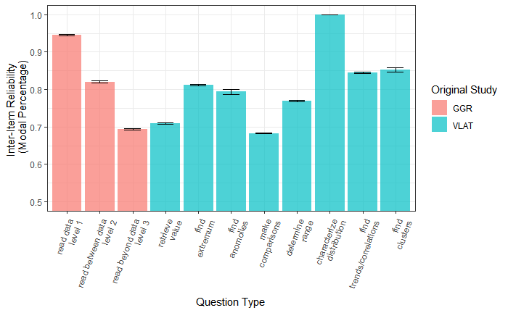
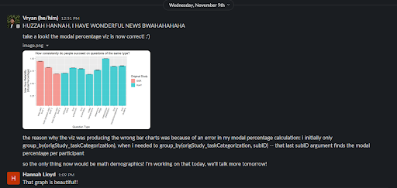
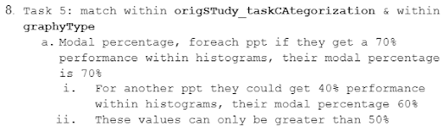
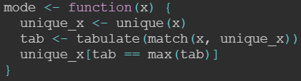
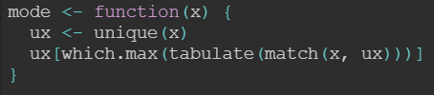
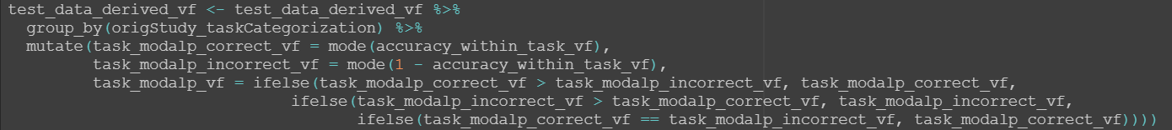

Does how consistently do people succeed on questions of the same type replicate?
Wait, what?
02
01
02
03
04
Notes:
So I had to troubleshoot, to check if my code was correct.
That explanation I gave you earlier was that correct explanation as verified by Professor and HL, so it must be my code:
Checked my code [CLICK]
Checked the mode function [CLICK] I borrowed from StackoverFlow, and then I grabbed another one just to make sure it wasn’t the function [CLICK]
But that wasn’t the issue! [CLICKFADEFADEFADE] So then I paused… [CLICK] Looked at the task again. [CLICK][CLICK] “per participant”... Okay, last time I did that, I was calculating accuracy! Let’s check that code. [CLICK] Okay, in that code I group_by()’d by question type and participant ID. OOOOHHHH, I DIDN’T GROUP_BY BY PARTICIPANTS [CLICK] OHHHHHHHHHHHHHHH
[CLICKFADEFADEFADECLICK] So I slapped that onto my inter-item-reliability code, and then produced this!
This graph replicates! I felt so proud. [CLICK] Hannah was the first person I let know.

Slide 19
Does how consistently do people succeed on questions of the same type replicate?
Does how consistently do people succeed on questions of the same graph replicate?
02
01
02
03
04
Notes:
But yeah! Let’s return: [CLICK] X-question type, [CLICK] y-inter-item reliability
[CLICK], [CLICK][PLOP][PLOP][PLOP] That ladder-like trend we saw for accuracy still persists here.
[CLICK] Increase in “determine range” accuracy ONLY
[CLICK] Overall, the trend is still the same compared to HLs! Let’s go check ITR for Graph Type!

Slide 20
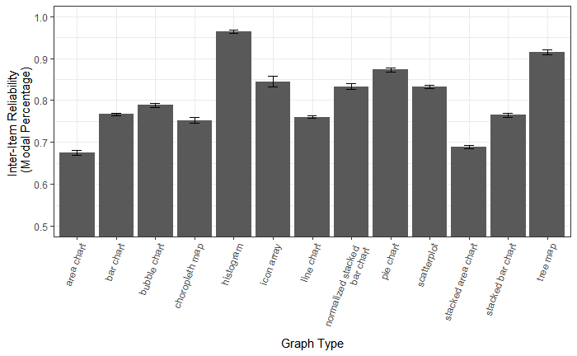
Does how consistently do people succeed on questions of the same type replicate?
Does how consistently do people succeed on questions of the same graph replicate?
02
01
02
03
04
Notes:
For inter-item reliability for graph type, here’s what I produced: [CLICK] X-graph type, [CLICK] y-inter-item reliability
Increases: [CLICK] scatterplot, [CLICK] bar chart, [CLICK] stacked bar chart
[CLICK] No discernable pattern

Slide 21
GCB REPLICATION RESULTS
Does how well people are doing on these tests and the types of questions that seem to be most difficult replicate?
Does how well people are doing on these graphs and the types of graphs that seem to be most difficult replicate?
Does how consistently do people succeed on questions of the same type replicate?
Does how consistently do people succeed on questions of the same graph replicate?
01
Accuracy increases for some tasks, compared to HL. Still, the trend has not changed: GGR results consistent w/ expected 3-level hierarchy, but no such clear hierarchy in VLAT results.
02
Successful replication: graphs have a weak association. Participants do well on graphs that are relatively common but are less accurate for more involved visualizations.
03
Successful replication: if either question type or graph type explained graph comprehension, they’re both only weakly reliable.
01
02
03
04
Notes:
Conclusion: [CLICK] read it [CLICK]

Slide 22
Replication conclusion
Does how well are people doing on these tests and which types of questions seem to be most difficult replicate?
REPLICATION CONCLUSION:
Does how well are people doing on these graphs and which types of graphs seem to be most difficult replicate?
Does how consistently do people succeed on questions of the same type replicate?
Does how consistently do people succeed on questions of the same graph replicate?
01
Accuracy increases for some tasks, compared to HL. Still, the trend has not changed: GGR results consistent w/ expected 3-level hierarchy, but no such clear hierarchy in VLAT results.
02
My replication study reinforces the trends and analysis conducted by its forerunner study:
We are measuring what we intended to measure, and our code correctly and accurately does so!
Successful replication: graphs have a weak association. Participants do well on graphs that are relatively common but are less accurate for more involved visualizations.
03
If either question types and graph types explained graph comprehension, they’re both only weakly reliable.
01
02
03
04
Notes:
[CLICK] Replication conclusion: we are measuring what we intended to measure, and our code correctly and accurately does so! [CLICK]

Slide 23
04.
MATH BACKGROUND exploratory analysis
01
02
03
04
Notes:
But that’s not all that I did! I also conducted an exploratory analysis based on a participant’s math background.

Slide 24
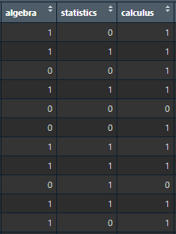

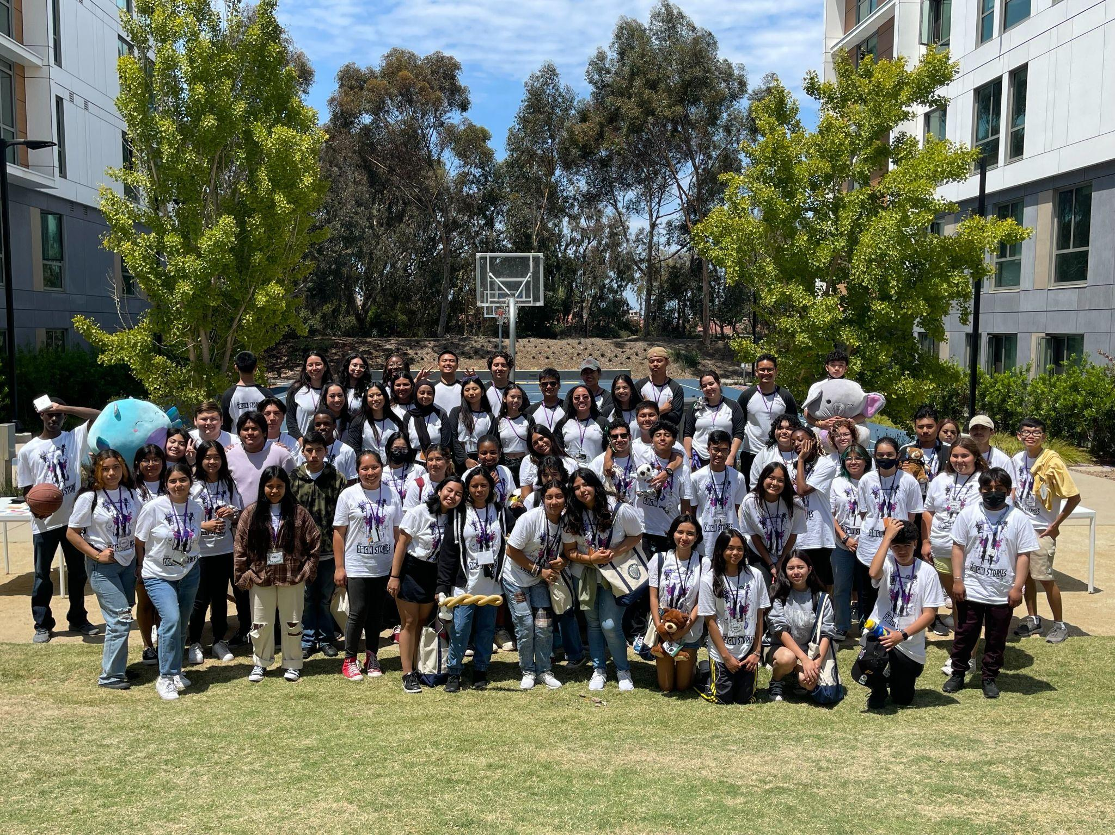
But that’s not all…
01
02
03
04
Notes:
First, let me talk about my research interests: I’m interested in data science pedagogy [CLICK], developing it and practicing it to [CLICK] students in high school and community college. Tangentially related to that is GCB: GCB can help us find what math/statistics skills students are already bringing into the classes I tutor/teach for, and where these students can improve!
[CLICK] HL brought to my attention that participant’s math background in terms of classes taken were recorded: they could have taken algebra, statistics, or calculus. And so I conducted an exploratory analysis.

Slide 25
GCB REPLICATION demographic QUESTIONS
How well are people doing on these tests based on number of classes taken?
How consistently do people succeed on questions based on number of classes taken?
Are there any differences between math classes taken and how well people do?
01
02
01
02
03
04
Notes:
Here are the questions I asked to guide me:
[CLICK] #1
[CLICK] #2

Slide 26
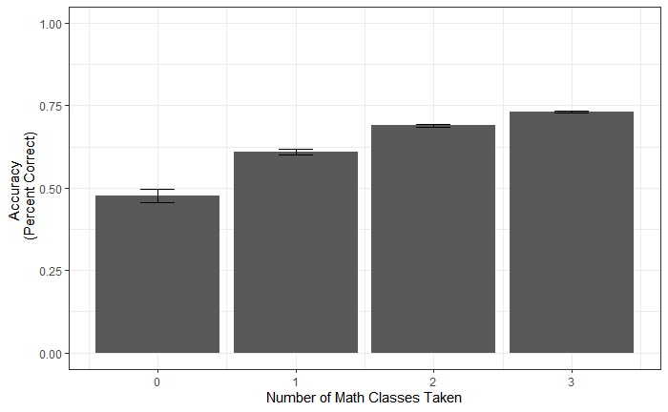
How well are people doing on these tests based on number of classes taken?
How consistently do people succeed on questions based on number of classes taken?
01
01
02
03
04
Notes:
This is the graph I produced: [CLICK] X - math composite; [CLICK] y - accuracy
LOOK AT THIS BEAUTIFUL LADDER TREND [CLICK][PLOP][PLOP][PLOP], THE MORE MATH THE BETTER ACCURACY
— – – –
X-axis “Math Composite Score” —> “Number of Math Classes Taken”; make it clearly they only had 4 options, what did they report?
Put a little legend? “Options of math classes”, before we show the data go through the x-axis and mention the options
—-
Coord cartesian here (include 0 - 1)

Slide 27
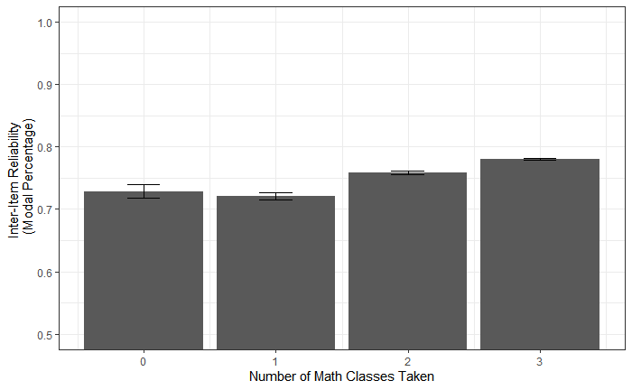
How well are people doing on these tests based on number of classes taken?
How consistently do people succeed on questions based on number of classes taken?
01
01
02
03
04
Notes:
How reliable is this? [CLICK] X-MATH composite score; [CLICK] y-inter-item reliability
All are around 0.7 modal percentage score — people answered neither reliably NOR unreliably! Notice that this is because 0.7 is approximately in the middle.
—---------------------
VF: what does it mean to have 0.7 in inter-item reliability?
HL: what does it mean that three classes has 0.79; someone with one class has ITR of 0.71
Sanity/Data check thing – are these meaningful separations of data; of they were, they’d have high ITR. what we got is both reliable and unreliable – 0.7 is the middle, so it’s aight. But there is variation If someone has 3 classes have ITR, their performance is higher; but the same thing applies for 0 classes, if people are performing low, they would still have 0.7 ITR – we wouldn’t know the difference
Someone asks questions… Are these groups reliably? “If this data did show that people who took 3 classes have closer ITR to 1 or 0 classes to 0.5, there’s a difference:”
There’s variation in our data, but they’re performing really similarly
Maybe this idea of number of math class background isn’t a great way to categorize the data

Slide 28
GCB REPLICATION demographic QUESTIONS
How well are people doing on these tests based on number of classes taken?
How consistently do people succeed on questions based on number of classes taken?
01
Strong ladder-like trend for accuracy based on number of classes taken. Participants are neither unreliable or reliable in their consistency.
01
02
03
04
Notes:
So what can we conclude? [CLICK] There’s a strong ladder-like trend for a participant’s accuracy, based on number of classes taken. Participants are neither unreliable or reliable in their consistency. [CLICK]

Slide 29
GCB REPLICATION demographic QUESTIONS
How well are people doing on these tests based on number of classes taken?
How consistently do people succeed on questions based on number of classes taken?
Are there any differences between math classes taken and how well people do?
01
Strong ladder-like trend for accuracy based on number of classes taken. Participants are neither unreliable or reliable in their consistency..
02
01
02
03
04
Notes:
Next question: [CLICK] are there any differences between math classes taken and how well people do?

Slide 30
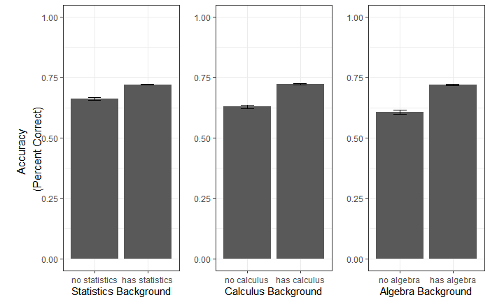
Are there any differences between math classes taken and how well people do?
02
01
02
03
04
Notes:
This is a bit more of an involved graph, let’s walk through it: [CLICK] X-axis is math background, in terms of if they’ve taken a particular class or not; [CLICK] y-axis is accuracy
First, stats/no stats – [CLICK] stats did better
Second, calc/no calc – [CLICK] calc did better
Third, algebra/no algebra – [CLICK] algebra did better
So having taken any kind of math is associated with higher accuracy; biggest difference is in algebra.

Slide 31
GCB REPLICATION demographic QUESTIONS
How well are people doing on these tests based on their math history?
How consistently do people succeed on questions based on their math background?
Are there any differences between math classes taken and how well people do?
01
Strong ladder-like trend for accuracy based on number of classes taken. Participants are neither unreliable or reliable in their consistency..
02
Participants who have previously taken any math class is associated with higher accuracy compared to those who have not.
01
02
03
04
Notes:
Conclusion? [CLICK] Participants who have previously taken any math class is associated with higher accuracy compared to those who have not. [CLICK]

Slide 32
CONCLUSIONS
01
02
REPLICATION RESULTS:
A larger sample with different code reproduced the trends in observed in HL’s FYP!
MATH BACKGROUND EXPLORATORY ANALYSIS:
There’s a relationship between a participant’s math background and how well they do on these tests.
01
02
03
04
Notes:
[CLICK] From our Replication, we can conclude that: a larger sample with different code reproduced the trends observed in HL’s FYP
[CLICK] From our Math Background Exploratory Analysis: there exists a relationship between a participant’s math background, and how well they do on these tests

Slide 33
GCB REPLICATION demographic QUESTIONS
How well are people doing on these tests based on their math history?
How consistently do people succeed on questions based on their math background?
MATH BACKGROUND EXPLORATORY ANALYSIS CONCLUSION:
Are there any differences between education backgrounds and how well people do?
01
Strong ladder-like trend for accuracy based on number of classes taken. The trend is reliable.
02
Based on our observations, there exists some relationship between a participant’s math background and how well they do on these tests.
Participants who have previously taken any math class have higher accuracy than those who have not.
01
02
03
04
Notes:
[CLICK] So in conclusion? [CLICK] There exists some relationship between a participant’s math background and how well they do on these tests.

Slide 34
THANKS!
Questions?
Vryan Feliciano
vfelicia@ucsd.edu
cognitivetoolslab - Fall 2022
Thank you Hannah for your mentorship >:(
Please keep this slide for attribution.
01
02
03
04

